Slide 1
Mapping Amdocs Portfolio to eTOM level 2
Contacts:
Corporate: Sigal Almog
Foundation: Gil Trotino, Alon Gayego
Customer Mngt: Collette Yee
Revenue Mngt: Rotem Ron Katzir
Service & Resource Mngt: Kfir Dan-Ari
Content: Shira Gottlieb
Full Coverage
Partial Coverage

Slide 2

ASOM and BPI Methodology
© 2004 - Proprietary and Confidential Information of Amdocs
Foundation
Customer Mngt
    Customer Interaction Manager
    Script Manager
    Amdocs Ordering
    Billing Manager
    Amdocs Support
    Amdocs Analytics Connector
    Amdocs Marketing Connector
    Amdocs Self Service Bill
    Amdocs Self Service Order
    Amdocs Self Service Support
    Amdocs Self Service Reports
    Amdocs Field Service
    Amdocs Logistics
    Sales
Revenue Mngt
Service & Resource Mngt
Content

Slide 3
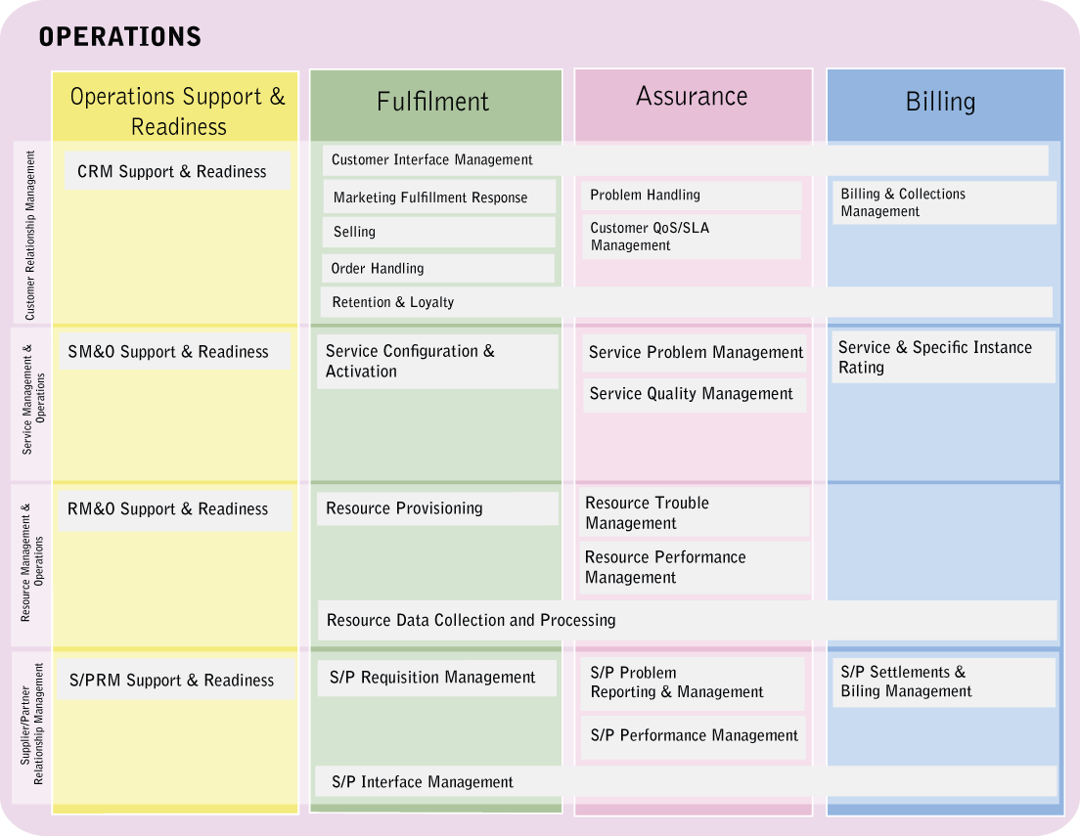
Mapping Customer Interaction Manager to eTOM: Operations, Level 2

Slide 4
Mapping Script Manager to eTOM:
Operations, Level 2

Slide 5
Mapping Amdocs Ordering to eTOM,
Operation, Level 2

Slide 6
Mapping Billing Manager to eTOM:
Operations, Level 2

Slide 7
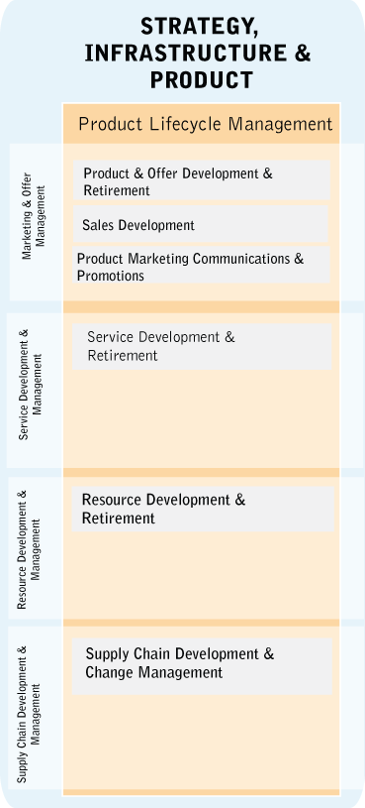
Mapping Amdocs Support to eTOM,
Operation, Level 2

Slide 8
Mapping Amdocs Analytics Connector to eTOM, Operation, Level 2

Slide 9
Mapping Amdocs Marketing Connector to eTOM, Operation, Level 2

Slide 10
Mapping Amdocs Self Service Bill to eTOM, Operation, Level 2

Slide 11
Mapping Amdocs Self Service Order to eTOM, Operation, Level 2

Slide 12
Mapping Amdocs Self Service Support to eTOM, Operation, Level 2

Slide 13
Mapping Amdocs Self Service Reports to eTOM, Operation, Level 2

Slide 14
Mapping Amdocs Field Service to eTOM,
Operation, Level 2

Slide 15
Mapping Amdocs Logistics to eTOM:
Operations, Level 2

Slide 16
Mapping Sales to eTOM:
Operations, Level 2

Slide 17
ASOM and BPI Methodology
© 2004 - Proprietary and Confidential Information of Amdocs
Foundation
Customer Mngt
Revenue Mngt
    Amdocs Charging
    Mediation
    Partner Manager
    Next Generation Convergent Billing Solution
    Account Receivable
    Collection
    Document Designer
    Subscriber Resource Manager
    Voucher manager
    Replenishment
    Balance manager
    Error Manager
    Partner Manager
    Fraud
Service & Resource Mngt
Content

Slide 18
Mapping Amdocs Charging to eTOM, Operation, Level 2

Slide 19
Mapping Amdocs Mediation to eTOM, Operation, Level 2

Slide 20
Mapping Amdocs Partner Manager to eTOM, Operation, Level 2

Slide 21
Mapping Next Generation Convergent Billing Solution to eTOM,
Operation, Level 2

Slide 22
Mapping Accounts Receivable to eTOM, Operation, Level 2

Slide 23
Mapping Amdocs Collections to eTOM, Operation, Level 2

Slide 24
Mapping Document Designer to eTOM, Operation, Level 2

Slide 25
Mapping Subscriber Resource Manager to eTOM, Operation, Level 2

Slide 26
Mapping Voucher Manager to eTOM, Operation, Level 2

Slide 27
Mapping Replenishment Manager to eTOM, Operation, Level 2

Slide 28
Mapping Balance Manager to eTOM, Level 2

Slide 29
Mapping Error Manager to eTOM, Level 2

Slide 30
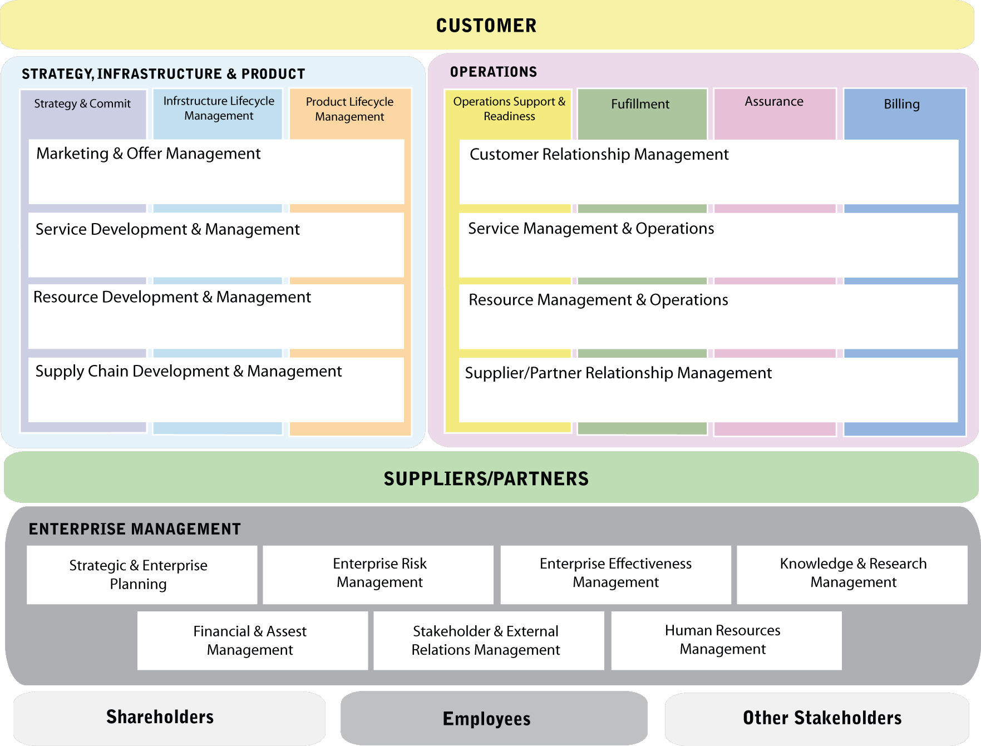
Mapping Fraud to eTOM, Level 2
Notes:
eTOM provides the Business View for NGOSS
Resume of the layers with horizontal & verticals – please note that horizontals are in line with the conceptual level
i.e. Service is the union of Service Development & Management + Service Management & Operations

Slide 31
ASOM and BPI Methodology
© 2004 - Proprietary and Confidential Information of Amdocs
Foundation
Customer Mngt
Revenue Mngt
Service & Resources Mngt
    B/OSS Manager
    Amdocs Service Order Manager
    Amdocs Support
    Amdocs SLA Manager …
    Amdocs Unified Service Manager
    Amdocs Service Catalog
    Amdocs Change Manager
    Amdocs Field Service
    Amdocs Logistics
    Amdocs Activation offering
    Cramer Resource Manager
    Cramer Task Engine
    Cramer Delivery Engine
    Cramer Sync Engine
    Cramer Discovery Engine
Content

Slide 32
Mapping Amdocs B/OSS Manager to eTOM, Operation, Level 2

Slide 33
Mapping Amdocs Service Order Manager to eTOM, Operation, Level 2

Slide 34
Mapping Amdocs Support to eTOM, Operation, Level 2

Slide 35
Mapping Amdocs SLA Manager to eTOM, Operation, Level 2

Slide 36
Mapping Amdocs Unified Service Manager to eTOM, Operation, Level 2

Slide 37
Mapping Amdocs Service Catalog to eTOM, Operation, Level 2

Slide 38
Mapping Amdocs Change Manager to eTOM, Operation, Level 2

Slide 39
Mapping Amdocs Field Service to eTOM, Operation, Level 2

Slide 40
Mapping Amdocs Logistics to eTOM, Operation, Level 2

Slide 41
Mapping Amdocs Activation offering to eTOM, Operation, Level 2

Slide 42
Mapping Cramer Resource Manager to eTOM, Operation, Level 2

Slide 43
Mapping Cramer Task Engine to eTOM, Operation, Level 2

Slide 44
Mapping Cramer Delivery Engine to eTOM, Operation, Level 2

Slide 45
Mapping Cramer Sync Engine to eTOM, Operation, Level 2

Slide 46
Mapping Cramer Discovery Engine to eTOM, Operation, Level 2

